Slide 1
Dragutin stražimir
Nadine Špoljarec, Ivo Andričić, Petar Turčić

Slide 2
Early life
he was born on 27 September 1821, Veliki Bukovec
his birthname was Karlo Wachter
his parents were Franz Wachter and Rozalija Manovec Wachter
his education started in 1828
he moved to Hungary and continued his education thanks to his godfather
he returned to Croatia in 1836 and went to Gymnasium in Zagreb

Slide 3
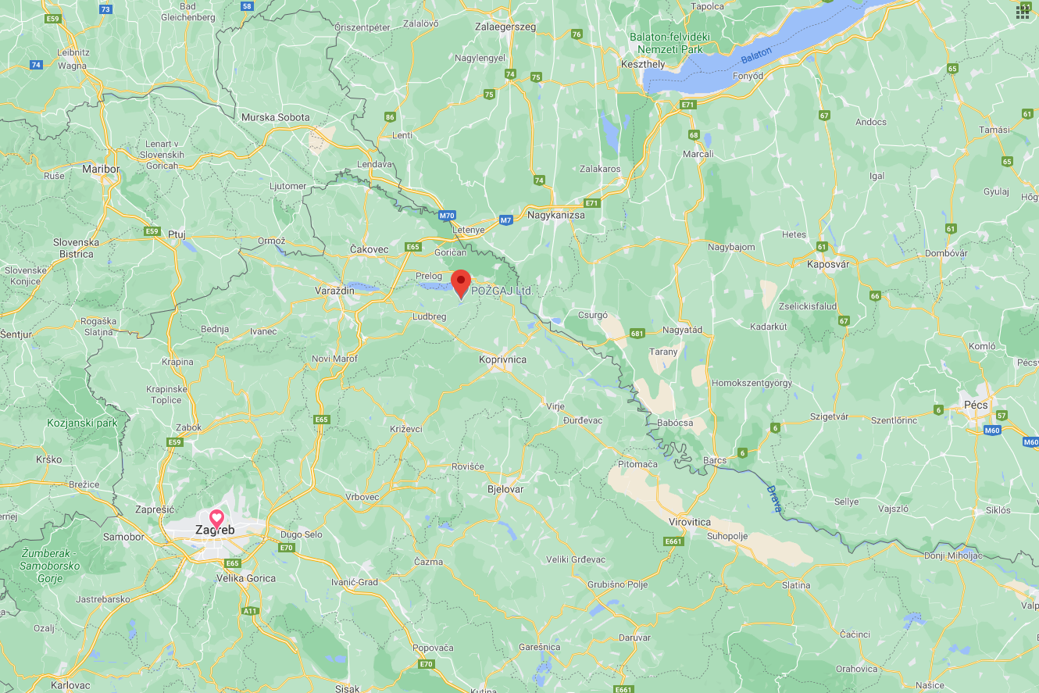
Source: Google maps

Slide 4
he enrolled in a theological school in 1839
he moved to Prague two years before finishing the school
he ordained in 1845 and strarted working as a priest near Ludbreg

Slide 5
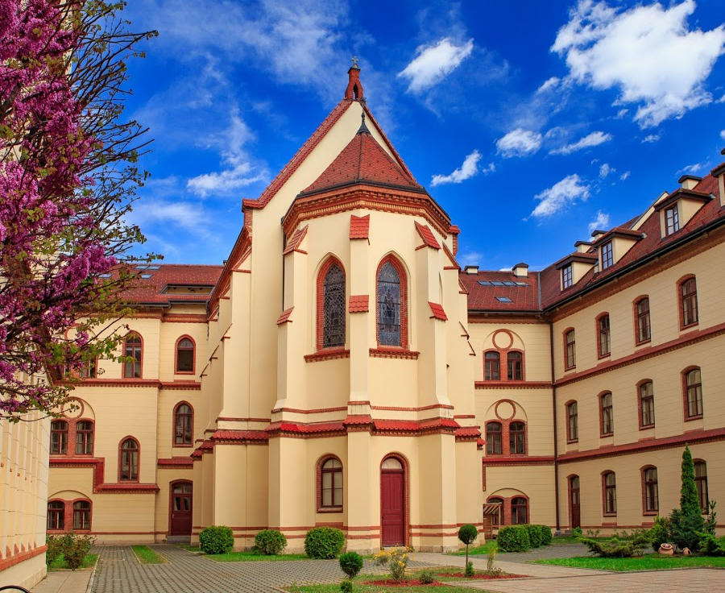
Source: Google drive

Slide 6
Adult life and career
Even though he was relatively wealthy, he always considered himself more of a peasant than a nobleman.
In 1848, he got in conflict with Hungarian nobelmen and then changed his name to Dragutin Stražimir as a sign of protest against Hungarian government.
In 1851 he became a Pastor in Donja Zelina.
Dragutin opened an elementary school in 1852 with 30 students.
He was donating most of his income to the school over the course of 23 years, which is why he lived a modest life.

Slide 7
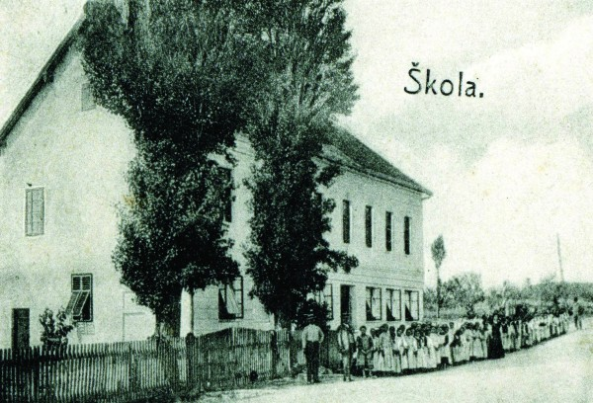
Source: Muzej Zelina

Slide 8
Thanks to his initiative, the newspaper „Gospodarski list” started being published.
He also organized the first trade fair of craftmanship in Croatia.
Motivated by the success of the fair, he planted 2 acres of vineyard.
He was promoted to a president of „Gospodarska podružnica Sveti Ivan Zelina”.
He won a bronze medal on a trade fair in Vienna.

Slide 9
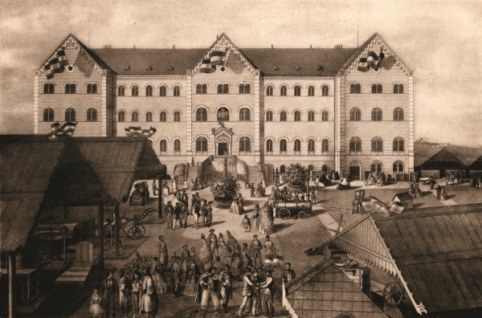
Source: Muzej Zelina

Slide 10
He published a collection of articles titled „Kratka pouka o vinogradarstvu” and sold them in 1500 copies, which was a whole lot.
Later on, those aricles were compiled into a standalone book titled „Vinogradar”.
One sort of corn was named after him - kukuruz stražimirovac.
He died of jaundice on 4 May in 1891.

Slide 11

writing
he wrote a book titled „Ratarstvo za puk”
he wrote a short story „Mijat Briguša hrvatski seljak”
his book „Vinogradar” can still be bought today
Source: Njuškalo

Slide 12
Vinogradarstvo je takova struka gospodarstva, koja se kod nas u vinorodnoj Hrvatskoj, ako se umno i pametno tjera, najbolje izplaća, premda i najviše posla zadaje.
Dragutin stražimir

Slide 13
Sources:
Muzej Zelina
Zelina.hr
Google Maps
Mira Kolar Wiki
CROSBI

